Slide 1

JAMSHACK23
NIT AGARTALA

Slide 2

ABOUT US
Kusuma: Kusuma is a full-stack developer who loves tackling complex challenges. With her expertise in multiple programming languages and frameworks, she bridges the gap between front-end and back-end development, bringing our projects to completion.
Satya: Satya is a talented front-end developer with a knack for creating seamless user experiences. She brings our designs to life by writing clean and efficient code, ensuring that our projects are not only visually appealing but also performant.
Vinay : Who keeps us focused, organized, and motivated to achieve our goals, ensuring our success in the Online Hackathon. With his guidance and expertise, we are confident in our ability to tackle any challenge that comes our way.
Together, we form a dynamic and innovative team, each bringing unique skills and perspectives to the table. Our shared goal is to collaborate, learn from one another, and create impactful solutions during this Online Hackathon. We believe that by combining our diverse talents, we can push the boundaries of technology and make a difference in the world.

Slide 3

Problem
STATEMENT: 1.1
DEVELOP AN APP TO BUILD THE FRONT END OF A WEBSITE . THE APP SHOULD ENABLE THE
USER TO CREATE FRONTEND OF A WEBSITE BY ADDIND PRE- MADE COMPONENTS LIKE
BUTTONS , CARDS , NAV BAR, TEXT- AREA, ETC.. JUST BY DRAGGING AND DROPPING
THOSE RSPECTIVE COMPONENTS

Slide 4
Solution
Collab of html ,css and java script
The power of HTML, CSS, and JavaScript lies in their seamless integration. HTML structures the content, CSS adds visual appeal and layout, and JavaScript brings interactivity and functionality. These three languages work in harmony, allowing developers to collaborate and leverage the strengths of each language to create a cohesive and user-centric website.
Building a website using HTML, CSS, and JavaScript is a dynamic and creative process. HTML provides the structure, CSS enhances visual appeal, and JavaScript adds interactivity and dynamic functionality. The combination of these languages empowers developers to create engaging and user-friendly websites that deliver a rich user experience. As technology continues to evolve, the mastery of these languages will remain fundamental in the world of web development.

Slide 5
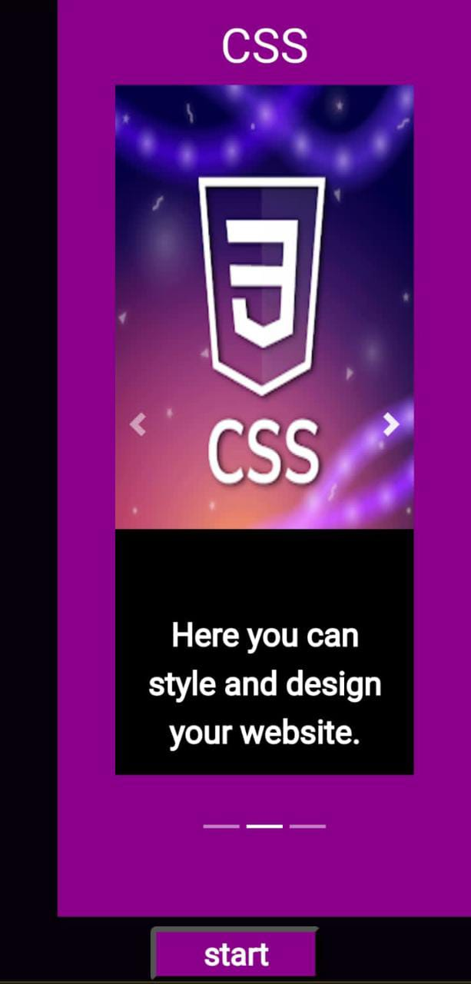
FIRST PAGE OR CAROUSEL PAGE

Slide 6
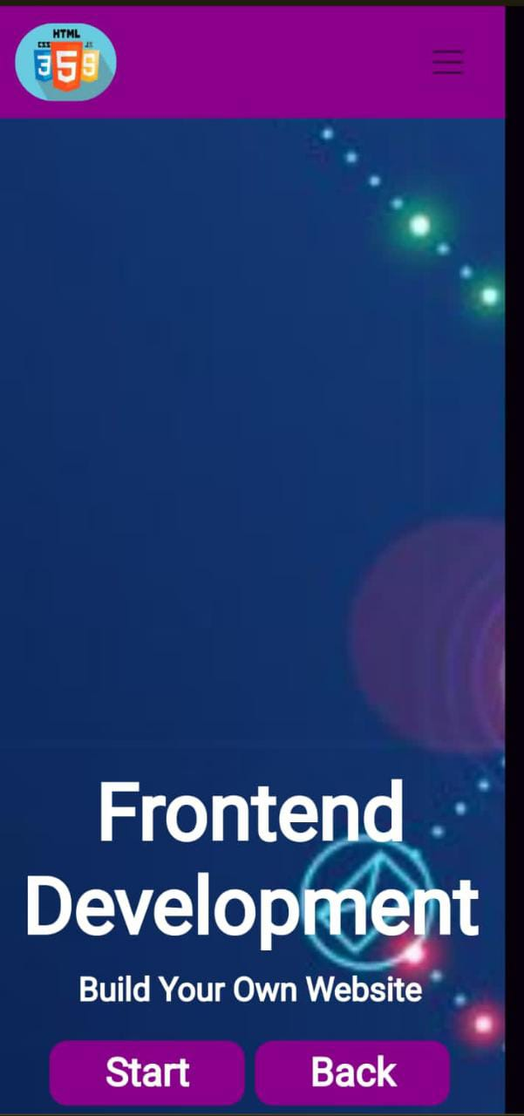
NAVBAR PAGE

Slide 7
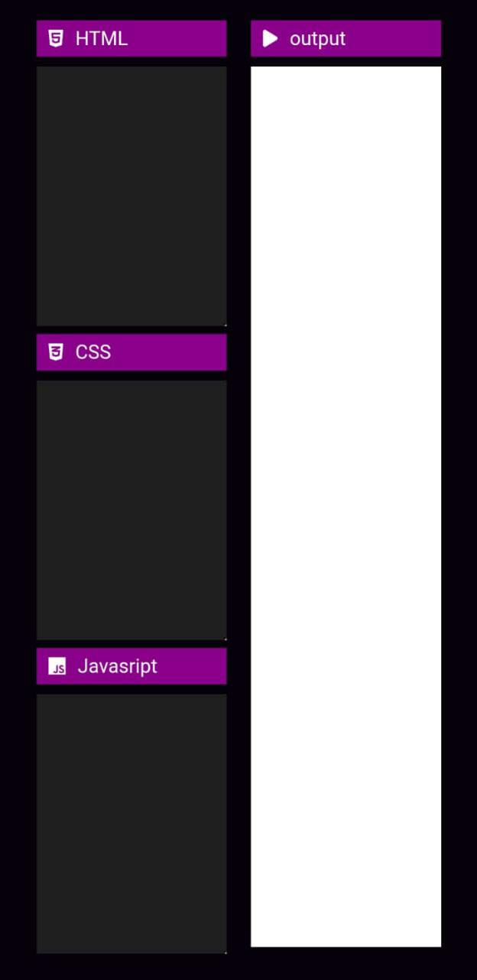
COMPILER PAGE

Slide 9
APPROACH:
FIRST PAGE:
Using bootstrap , corousel and navigations .
“START” button to reach second page by clicking on it.
SECOND PAGE:
Using navbar from bootstrap.
Included start button and back button.
Start button to open compiler.
Back button to go back towards home page.
THIRD PAGE:
The compiler takes all the input given by the user and runs it.
We used HTML,CSS and java script functions .

Slide 10


ProJECT Overview
Unique
Tested
Only product specifically dedicated to task management​
Conducted testing within
ourselves

Slide 11

Product benefits
Simple and efficient to use​.
Runs all frontend code with efficiency.
​​

Slide 12

WEBSITE LINK
hackerjacks.ccbp.tech

Slide 13
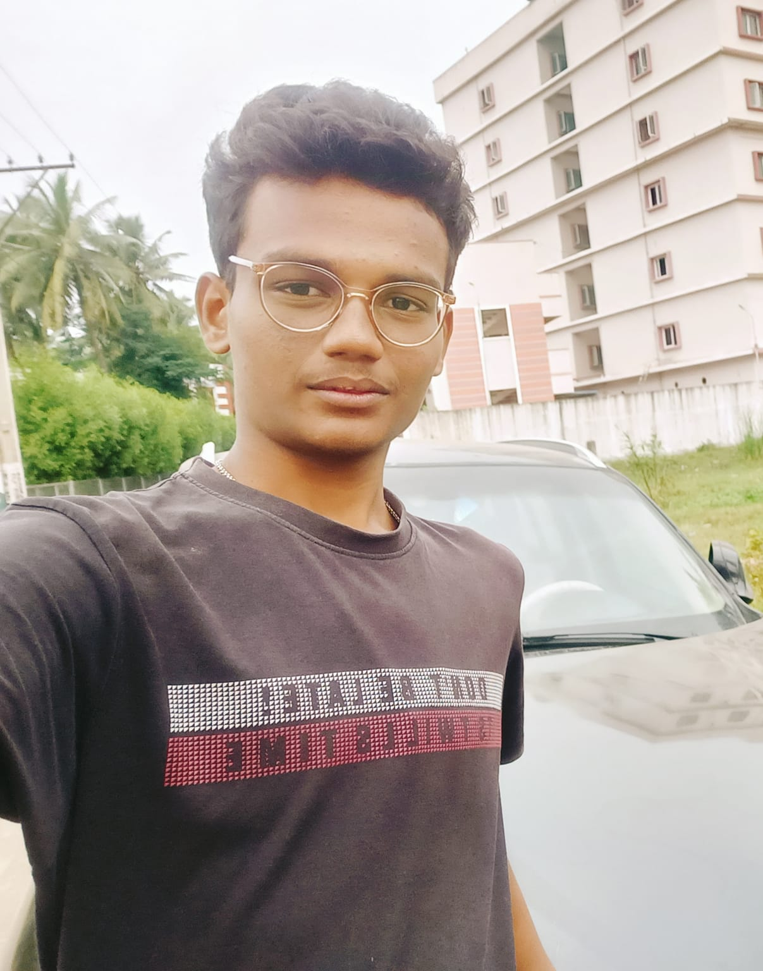
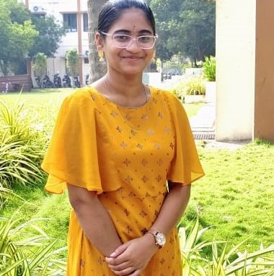
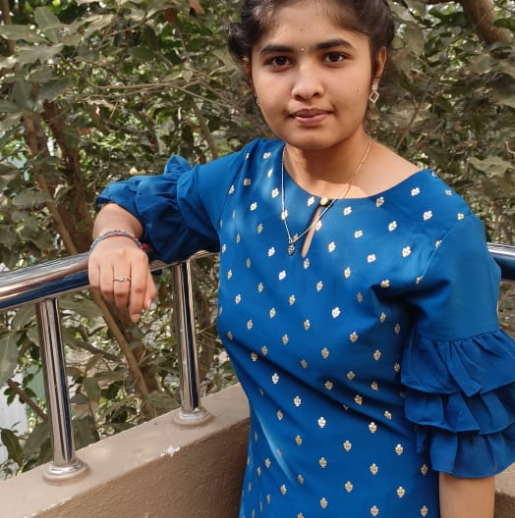
Meet the team
vinay​​
satya​​
kusuma​
President​
Chief Executive Officer​
Chief Operations Officer​

Slide 14

Summary:
We explored the construction of a website using HTML, CSS, and JavaScript. HTML serves as the backbone, providing structure and content organization. CSS enhances the visual appeal and layout, ensuring a consistent and professional design. JavaScript adds interactivity and dynamic functionality, allowing for user engagement and real-time updates. The integration of these three languages enables developers to collaborate and create user-friendly websites that deliver a rich user experience. Mastering HTML, CSS, and JavaScript remains fundamental in the ever-evolving world of web development.."

Slide 15

Thank you
TEAM: HACKER JACKS

